Slide 1

CS 584 Machine Learning
Week 13
April 10, 2019

Slide 2

Week 13 Agenda
Mid-Term Test Review
Support Vector Machine
Chapter 13 of the Machine Learning book

Slide 3
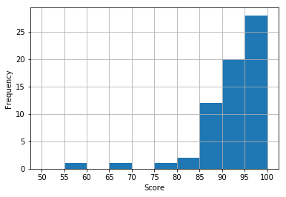
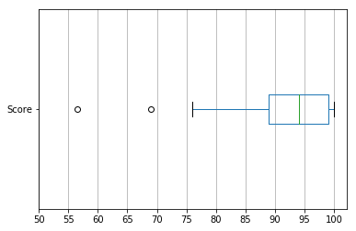
Mid-Term Test Review
Count | Mean | S.D. | Q1 | Median | Q3 | Max
65 | 92.7 | 7.6 | 89.0 | 94.0 | 99.0 | 100.0

Slide 4
Mid-Term Test Review
# | Question | Maximum Score | Average Score | Standard Deviation
1 | Interquartile Range (IQR) ... | 5 | 5 | 0
2 | Pearson Chi-Squared statistic and significance ... | 5 | 4.72 | 1.01
3 | Entropy of root node … | 5 | 4.93 | 0.63
4 | Maximum Gini’s value ... | 5 | 5 | 0
5 | Prob(Burglary=T, Earthquake=F | Alarm=T) ... | 5 | 4.93 | 0.63
6 | Intercept in Logistic … | 5 | 5 | 0
7 | Area Under Curve … | 5 | 5 | 0
8 | Misclassification Rate … | 5 | 5 | 0
9 | Number of 4-itemset ... | 5 | 5 | 0
10 | Accumulated lift of decile 4 ... | 5 | 4.93 | 0.63
11 | Cluster + Classification Tree ... | 25 | 22.39 | 4.35
12 | Compare Classification Tree vs Logistic … | 25 | 20.82 | 4.67

Slide 5
Question 1
The first quartile is the 11*0.25 = 2.75-th observation and the third quartile is the 11*0.75 = 8.25-th observation. The ambiguity is how to define where the fractionally-indexed observations are.
If you accept that the first quartile is the median of the lower half data and the third quartile is the median of the upper half data, then the first quartile Q1 = 0.0005 and the third quartile Q3 = 0.7305. Therefore, the interquartile range IQR = 0.7305 – 0.0005 = 0.73.

Slide 6
Question 1
If you use the Percentile function in the Numpy package, then the first quartile Q1 = 0.0013 and the third quartile Q3 = 0.4558. Therefore, the interquartile range IQR = Q3 – Q1 = 0.4558 – 0.0013 = 0.4545.
q1Data = numpy.array([0.1811, 0.0775, 0.1279, 0.0045, 0.0001, 0.9457, 0.0021, 0.0000, 0.0005, 0.7305, 0.8936])
q1Q1 = numpy.percentile(q1Data, 25)
q1Q3 = numpy.percentile(q1Data, 75)
q1IQR = q1Q3 - q1Q1
print('Q1 = {:.4f} '.format(q1Q1))
print('Q3 = {:.4f} '.format(q1Q3))
print('Interquartile Range = {:.4f} '.format(q1IQR))
Q1 = 0.0013
Q3 = 0.4558
Interquartile Range = 0.4545

Slide 7
Question 2
q2Data = numpy.array([[6815, 2254],
[492, 312],
[212, 139],
[37, 41]])
q2Expected = numpy.outer(q2Data.sum(axis = 1), (q2Data.sum(axis = 0) / q2Data.sum(axis = None)))
print('Expected Observations:')
print(q2Expected)
Expected Observations:
[[6651.6564 2417.3436]
[ 589.6937 214.3063]
[ 257.4409 93.5591]
[ 57.2091 20.7909]]
q2Chi = (q2Data - q2Expected)**2 / q2Expected
q2ChiSquare = q2Chi.sum(axis = None)
q2ChiSig = scipy.stats.chi2.sf(q2ChiSquare, 3)
print(' Chi-Squared Statistic = {:.4f} '.format(q2ChiSquare))
print('Chi-Squared Significance = {:.4e} '.format(q2ChiSig))
Chi-Squared Statistic = 132.6414
Chi-Squared Significance = 1.4582e-28

Slide 8
Question 2
# Alternatively
q2Data = numpy.array([[6815, 2254],
[492, 312],
[212, 139],
[37, 41]])
q2ChiResult = scipy.stats.chi2_contingency(q2Data)
print(q2ChiResult)
(132.64137110246577, 1.4581753275490453e-28, 3,
array([[6651.6564, 2417.3436],
[ 589.6937, 214.3063],
[ 257.4409, 93.5591],
[ 57.2091, 20.7909]]))

Slide 9
Question 3
q3Data = numpy.array([64, 250, 364, 259, 63])
q3Prop = q3Data / q3Data.sum(axis = None)
print('Observed Proportion\n')
print(q3Prop)
Observed Proportion
[0.064 0.25 0.364 0.259 0.063]
q3E = q3Prop * numpy.log2(q3Prop)
print(q3E)
[-0.2538 -0.5 -0.5307 -0.5048 -0.2513]
q3RootEntropy = - q3E.sum(axis = None)
print('Root Entropy = {:.4f} '.format(q3RootEntropy))
Root Entropy = 2.0406

Slide 10

Question 4
The maximum Gini’s value is attained when the probabilities are equal. In other words, each probability is 1/5.
The maximum Gini’s value is $1−\sum_{1}^{5}{{\left(\frac{1}{5}\right)}^{2}}=1−5×\frac{1}{25}=1−\frac{1}{5}=0.8$.

Slide 11
Question 5
Alarm | Burglary | Earthquake | Prob(Alarm | Burglary, Earthquake) | Prob(Burglary) | Prob(Earthquake) | Prob(Alarm, Burglary, Earthquake)
TRUE | TRUE | TRUE | 0.99 | 0.06 | 0.02 | 0.001188
TRUE | FALSE | TRUE | 0.15 | 0.94 | 0.02 | 0.00282
TRUE | TRUE | FALSE | 0.95 | 0.06 | 0.98 | 0.05586
TRUE | FALSE | FALSE | 0.0001 | 0.94 | 0.98 | 0.00009212
The marginal probabilities for Alarm are
Prob(Alarm = TRUE) = 0.001188 + 0.00282 + 0.05586 + 0.00009212 = 0.05996012
Prob(Alarm = FALSE) = 1 – Prob(Alarm = TRUE) = 1 - 0.05996012 = 0.94003988.
The conditional probability Prob(Burglary = True and Earthquake = False | Alarm Sounded = True) = Prob(Burglary = True and Earthquake = False and Alarm Sounded = True) / Prob(Alarm = TRUE) = 0.05586 / 0.05996012 = 0.9316.

Slide 12
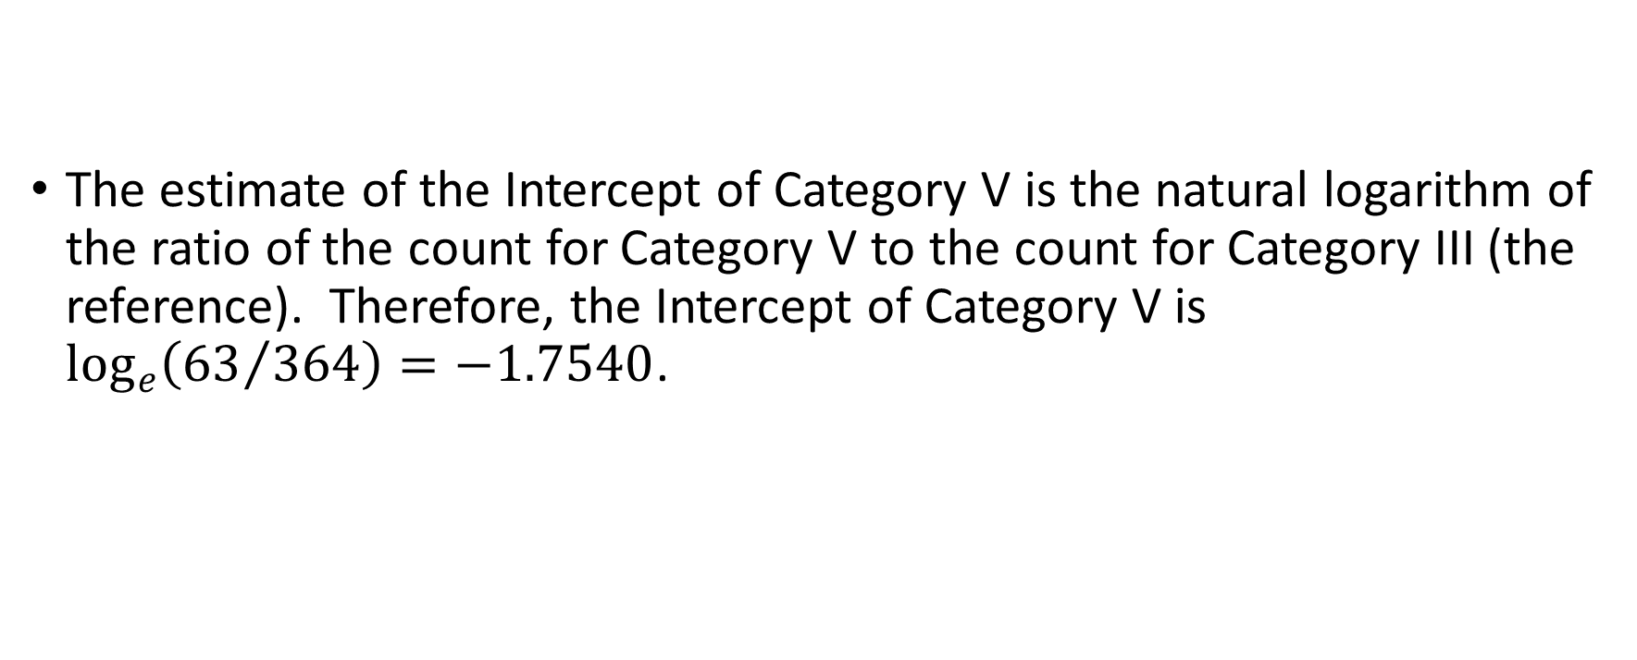
Question 6
Target Category | I | II | III | IV | V
Frequency | 64 | 250 | 364 | 259 | 63
The estimate of the Intercept of Category V is the natural logarithm of the ratio of the count for Category V to the count for Category III (the reference). Therefore, the Intercept of Category V is $\log_{e}\left({63}/{364}\right)=−1.7540$.

Slide 13
Question 7
Observed Event | Observed Non-Event
 | 0.4 | 0.5 | 0.5 | 0.7
0 | D | D | D | D
0.4 | T | D | D | D
0.6 | C | C | C | D
0.6 | C | C | C | D
0.7 | C | C | C | T
0.8 | C | C | C | C
There are 13 concordant (C) pairs, 9 discordant (D) pairs, and 2 tied (T) pairs.
The Area Under Curve statistic is equal to 0.5 + 0.5 * (13 – 9) / 24 = 0.5 + 0.5 * 4 / 24 = 0.5833.
q7Obs = numpy.array([1,0,0,1,1,0,1,0,1,1])
q7PredProb = numpy.array([0.8, 0.5, 0.4, 0.6, 0.4, 0.7, 0.0, 0.5, 0.7, 0.6])
q7AUC = metrics.roc_auc_score(q7Obs, q7PredProb)
print('Area Under Curve = {:.4f} '.format(q7AUC))
Area Under Curve = 0.5833

Slide 14
Question 8
q8Obs = numpy.array([1,0,0,1,1,0,1,0,1,1])
q8PredProb = numpy.array([0.8, 0.5, 0.4, 0.6, 0.4, 0.7, 0.0, 0.5, 0.7, 0.6])
q8Thresh = q8Obs.mean()
q8PredClass = numpy.where(q8PredProb >= q8Thresh, 1, 0)
q8MisC = numpy.not_equal(q8PredClass, q8Obs)
q8MisClassRate = q8MisC.mean()
print('Misclassification Rate = {:.4f} '.format(q8MisClassRate))
Misclassification Rate = 0.3000
#Alternatively
q8MisClassRate = 1.0 - metrics.accuracy_score(q8Obs, q8PredClass)
print('Misclassification Rate = {:.4f} '.format(q8MisClassRate))
Misclassification Rate = 0.3000

Slide 15
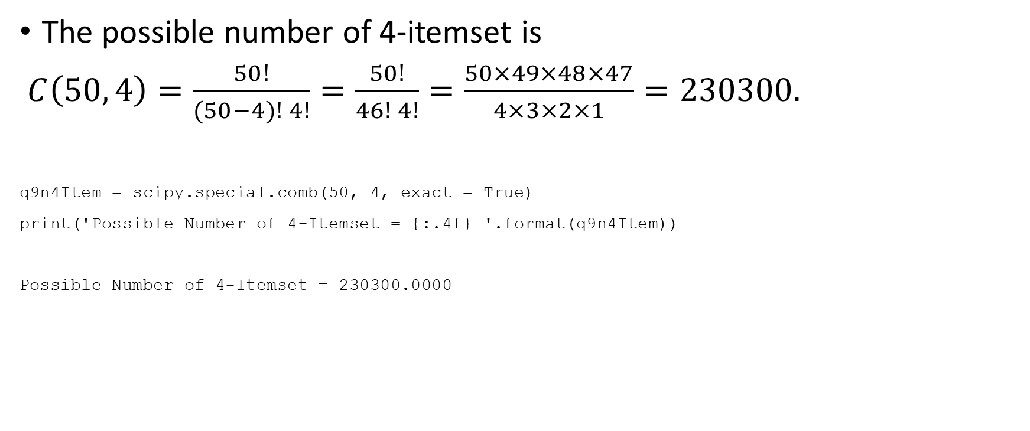
Question 9
The possible number of 4-itemset is
$C\left(50, 4\right)=\frac{50!}{(50−4)! 4!}=\frac{50!}{46! 4!}=\frac{50×49×48×47}{4×3×2×1}=230300.$
q9n4Item = scipy.special.comb(50, 4, exact = True)
print('Possible Number of 4-Itemset = {:.4f} '.format(q9n4Item))
Possible Number of 4-Itemset = 230300.0000

Slide 16
Question 10
Decile | Acc. Decile N | Acc. Decile % | Acc. Gain N | Acc. Gain % | Acc. Response % | Acc. Lift
1 | 421 | 10% | 155 | 40.4% | 36.8% | 4.0432
2 | 843 | 20% | 207 | 53.9% | 24.6% | 2.6966
3 | 1265 | 30% | 233 | 60.7% | 18.4% | 2.0227
4 | 1687 | 40% | 252 | 65.6% | 14.9% | 1.6404
5 | 2108 | 50% | 274 | 71.4% | 13.0% | 1.4274
6 | 2530 | 60% | 301 | 78.4% | 11.9% | 1.3065
7 | 2952 | 70% | 325 | 84.6% | 11.0% | 1.2090
8 | 3374 | 80% | 344 | 89.6% | 10.2% | 1.1197
9 | 3796 | 90% | 362 | 94.3% | 9.5% | 1.0473
10 | 4217 | 100% | 384 | 100.0% | 9.1% | 1.0000
The accumulated lift value of the fourth decile is 1.6404.

Slide 17
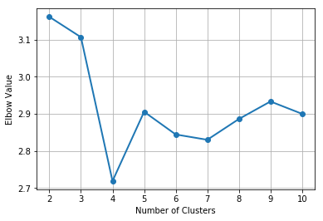
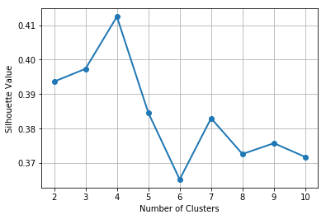
Question 11
Read 2019S1MT_Q11.py
The Elbow chart shows an elbow at the 4-cluster solution and the Silhouette chart shows a peak at the 4-cluster solution. Therefore, we determine the number of clusters as 4.

Slide 18
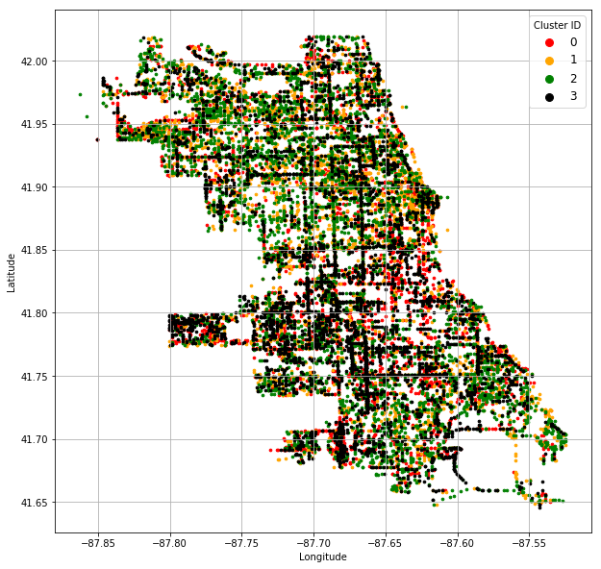
Question 11
It is common sense to insert the legend that shows the marker’s color of each cluster.

Slide 19
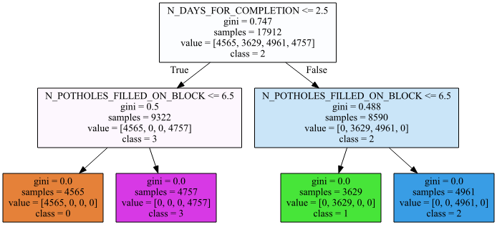
Question 11
Four terminal nodes or leaves.
Since the Gini value of each leaf is zero, this indicates that all observations in each leaf come from the same cluster and they are completely and correctly classified. Therefore, the Root Average Squared Error is zero.

Slide 20
Question 11
Cluster ID | Size | N_DAYS_FOR_COMPLETION | N_POTHOLES_FILLED_ON_BLOCK
0 | 4,565 | <= 2.5 | <= 6.5
1 | 3,629 | > 2.5 | <= 6.5
2 | 4,961 | > 2.5 | > 6.5
3 | 4,757 | <= 2.5 | > 6.5
Cluster 0 has 4,565 reports. In those reports, 6 or fewer potholes were filled on the block within 2 days of receiving the reports.
Cluster 1 has 3,629 reports. In those reports, 6 or fewer potholes were filled on the block but after at least 3 days of receiving the reports.
Cluster 2 has 4,961 reports. In those reports, 7 or more potholes were filled on the block after at least 3 days of receiving the reports.
Cluster 3 has 4,757 reports. In those reports, 7 or more potholes were filled on the block within 2 days of receiving the reports.

Slide 21
Question 12
Read 2019S1MT_Q12.py
The Training partition has 462 observations and the Testing partition has 155 observations.
The claim rate in the Training partition is 133 / (329 + 133) = 0.2879.
 | Classification Tree | Logistic
Area Under Curve | 0.4351 | 0.5463
Root Average Squared Error | 0.5089 | 0.4539
Misclassification Rate | 0.4581 | 0.4839

Slide 22
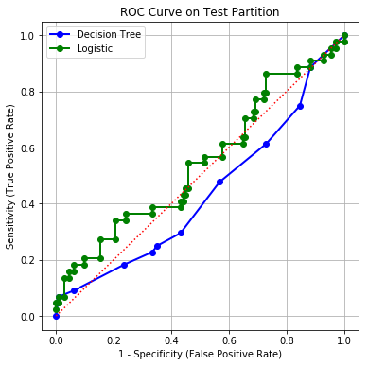
Question 12
The Logistic Regression model has a higher Area Under Curve metric and a lower Root Average Squared Error. On the other hand, the Decision Tree model has a lower Misclassification Rate.
In the Receiver Operating Characteristic chart, the curve of the Logistic Regression model is above that of the Decision Tree model most, if not all, of the time. In fact, the curve of the Decision Tree model falls below the diagonal reference line the majority of the time. This indicates that the Decision Tree is worse than a uniformly random model.
In summary, the Logistic Regression model wins 3 out of 4 criteria, and the Decision Tree model only wins in the Misclassification Rate criterion. Therefore, I will recommend the Logistic Regression model.

Slide 23
Python Codes
Question 1 to Question 10: 2019S1MT_Q1_10.py
Question 11: 2019S1MT_Q11.py
Question 12: 2019S1MT_Q12.py

Slide 24
A Few Remarks
Score Inquiry or Request to Regrade
Send the instructor email about your inquiry or request no later than Friday, April 12, 2019
Must state your evidence that your answers are misread or misinterpreted
Your Course Status Check
Your running course score equals to 0.1 * Assignment1 + 0.1 * Assignment2 + 0.1 * Assignment3 + 0.25 * Mid-Term
If your running course score is below 25, then you definitely will fail this course even if you earned maximum scores in Assignment 3 and 4, and the Final.

Slide 25
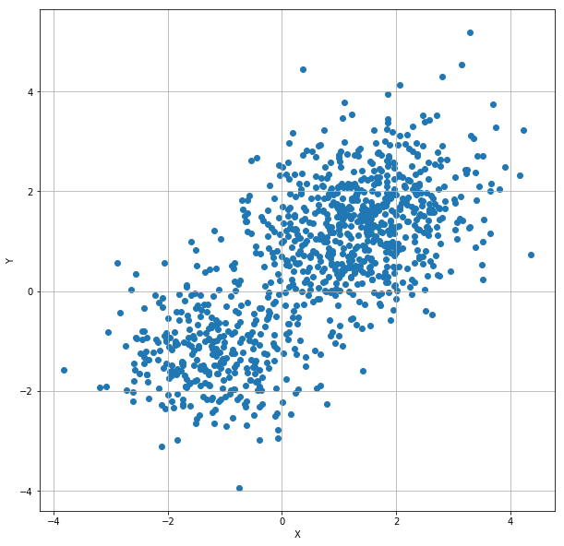
A Classification Problem
1,000 observations
Interval features: X and Y
If I tell you that these points come from two multivariate normal populations, then how will you divide these points into two groups?
Week 13 Toy MVN.py

Slide 26
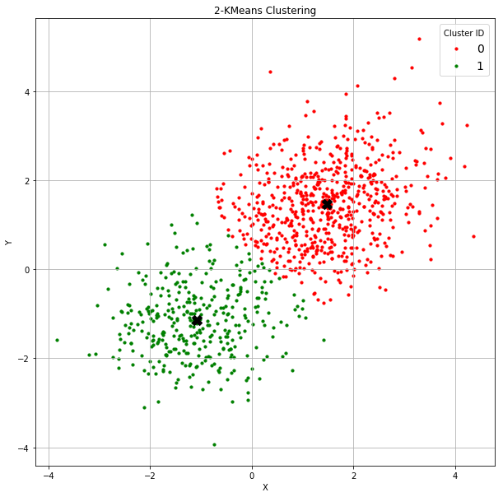
K-Means Algorithm Revisited
You may apply the K-means clustering algorithm to find two clusters.
The Centroids, marked X in the chart, are: [[ 1.46733873 1.46039557] [-1.08297405 -1.14699599]]
Do you think the clustering algorithm has done a good job in classifying the observations?

Slide 27

A Supervised Classification Problem
I supposedly know the prior grouping information.
Some red points mingled with the green points.
Can you develop a classifier that classifies each observation into one of the two classes?

Slide 28
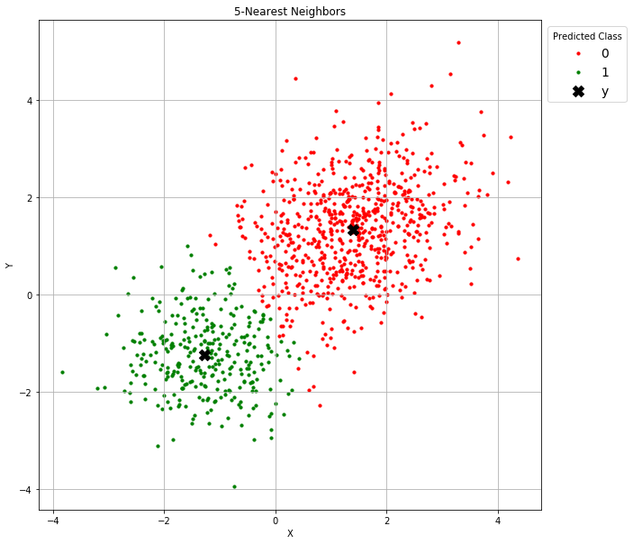
Nearest Neighbor Algorithm Revisited
You may try the nearest neighbors classifier.
Suppose I consider the 5-neighbors solution
The means of the predicted class, marked X in the chart, are: [[ 1.389441 1.338608] [-1.271928 -1.245927]]
The mean accuracy is 0.977
Do you think the nearest neighbor algorithm has done a good job in classifying the observations?

Slide 29

Multinomial Logistic Algorithm Revisited
You may try the multinomial logistic model classifier.
The means of the predicted class, marked X in the chart, are: [[ 1.371424 1.337239] [-1.274450 -1.285303]]
The mean accuracy is 0.976
Do you think the multinomial logistic algorithm has done a good job in classifying the observations?

Slide 30
True Populations Revealed
 | Means of Population 1 |  | Mean of Population 2
 | x | y | x | y
K-Means | 1.4673 | 1.4604 | -1.0830 | -1.1470
5-Nearest Neighbor | 1.3894 | 1.3386 | -1.2719 | -1.2459
Multinomial Logistic | 1.3714 | 1.3372 | -1.2745 | -1.2853
True | 1.3 | 1.3 | -1.3 | -1.3
Comments:
The multinomial logistic model and the 5-Nearest Neighbor model have practically the same accuracy (0.976 vs. 0.977), but the multinomial logistic model predicts the population means closer to the true values.
It is not unexpected to see poorer estimates of the population means from the K-means algorithm

Slide 31
Predictions of Algorithms
K-Means is a “Follow the Leaders” prediction. The leaders are the clusters’ centroids. An observation is assigned to the cluster if the observation is closest to the cluster’s centroid.
Nearest Neighbor is a “Go Along with the Crowd” prediction. The crowd consists of the neighbors. An observation takes the majority opinion of the crowd.
Multinomial Logistic is a “Personality Test” prediction. Each attribute of an observation individually contributes a weight to the logit (i.e., log-odds) of belonging to a particular population.

Slide 32
Pros and Cons of Predictions of Algorithms
Algorithm | Pros | Cons
K-Means | Only need to know the centroids for prediction | The predictions are reliable only if the number of clusters is correct. Need to calculate the distance metric.
Nearest Neighbor | Only need to know the number of neighbors. A instance/memory-based learning model | The predictions are reliable only if the number of neighbors is correct for every observation. Need to calculate the distance metric. Need to carry the whole training data for prediction.
Multinomial Logistic | Only need to know the parameter estimates (i.e., the weights). Allows us to visualize the impacts of the attributes on the predictions. | Correlations among attributes have to be explicitly specified in the model. May suffer from non-convergence and floating-point numerical problems.

Slide 33
Draw-A-Line-In-The-Sand Prediction
Goal: Correct classification of observations
Don’t
Need to know the characteristics (e.g., means ) of the populations
Need to know the likelihood of belonging to a population
Want to carry the training data everywhere for prediction
Want to calculate the distance metric or the logit
Do
Work well for future observations
Require only simple arithmetic calculations for prediction
Support Vector Machines (SVM) offer a “Draw a Line in the Sand” prediction

Slide 34
History of Support Vector Machines
The original Support Vector Machines algorithm was invented in 1963 by Vladimir Naumovich Vapnik (1936-present) and Alexey Yakovlevich Chervonenkis (1938-2014) at the Institute of Control Sciences of the Russian Academy of Sciences, Moscow, Russia.
In 1992, Bernhard E. Boser, Isabelle M. Guyon, and Vladimir N. Vapnik suggested an improvement on the original support vector machine which allows for the creation of nonlinear classifiers.
https://www.kdnuggets.com/2016/07/guyon-data-mining-history-svm-support-vector-machines.html
https://link.springer.com/chapter/10.1007%2F978-3-642-41136-6_3

Slide 35
Overview of Support Vector Machines
A Support Vector Machine is a discriminative classifier formally defined by a separating hyperplane.
A Support Vector Machine is a large-margin linear classifier.
Support Vector Machines become popular because it can successfully solve many classification problems.
A machine is a device or an algorithm that performs a particular task (classification in this case) with a definite goal.

Slide 36
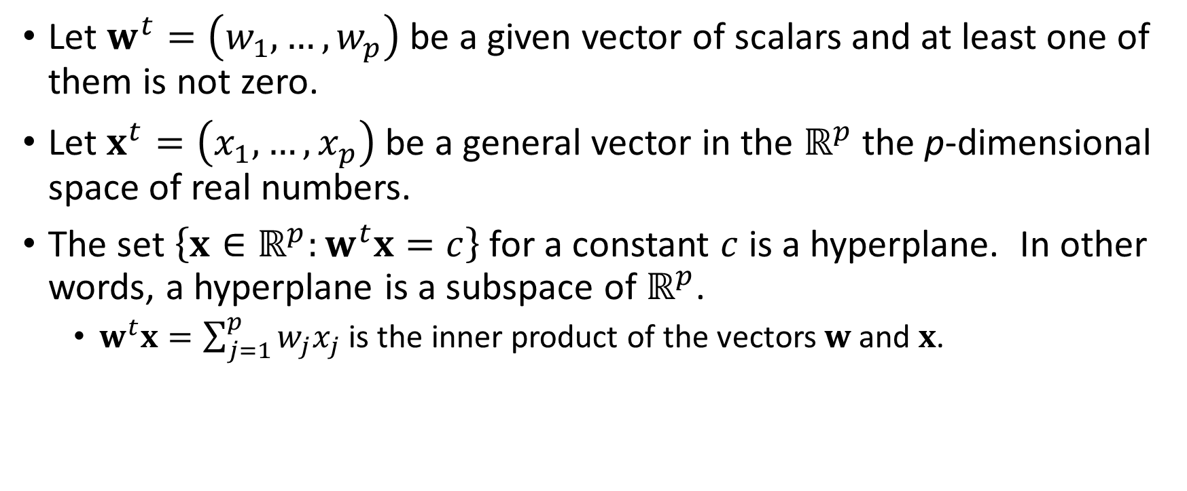
What is Hyperplane?
Let $w^{t}=\left(w_{1},…,w_{p}\right)$ be a given vector of scalars and at least one of them is not zero.
Let $x^{t}=\left(x_{1},…,x_{p}\right)$ be a general vector in the $ℝ^{p}$ the p-dimensional space of real numbers.
The set $\left\{x∈ℝ^{p}:w^{t}x=c\right\}$ for a constant $c$ is a hyperplane. In other words, a hyperplane is a subspace of $ℝ^{p}$.
$w^{t}x=\sum_{j=1}^{p}{w_{j}x_{j}}$ is the inner product of the vectors $w$ and $x$.

Slide 37
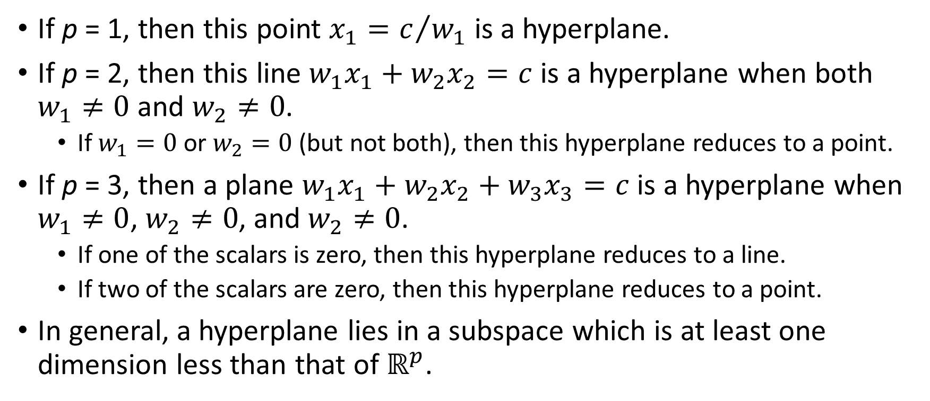
Examples of a Hyperplane
If p = 1, then this point $x_{1}=c/{w_{1}}$ is a hyperplane.
If p = 2, then this line $w_{1}x_{1}+w_{2}x_{2}=c$ is a hyperplane when both $w_{1}≠0$ and $w_{2}≠0$.
If $w_{1}=0$ or $w_{2}=0$(but not both), then this hyperplane reduces to a point.
If p = 3, then a plane $w_{1}x_{1}+w_{2}x_{2}+w_{3}x_{3}=c$ is a hyperplane when $w_{1}≠0$, $w_{2}≠0$, and $w_{2}≠0$.
If one of the scalars is zero, then this hyperplane reduces to a line.
If two of the scalars are zero, then this hyperplane reduces to a point.
In general, a hyperplane lies in a subspace which is at least one dimension less than that of $ℝ^{p}$.

Slide 38
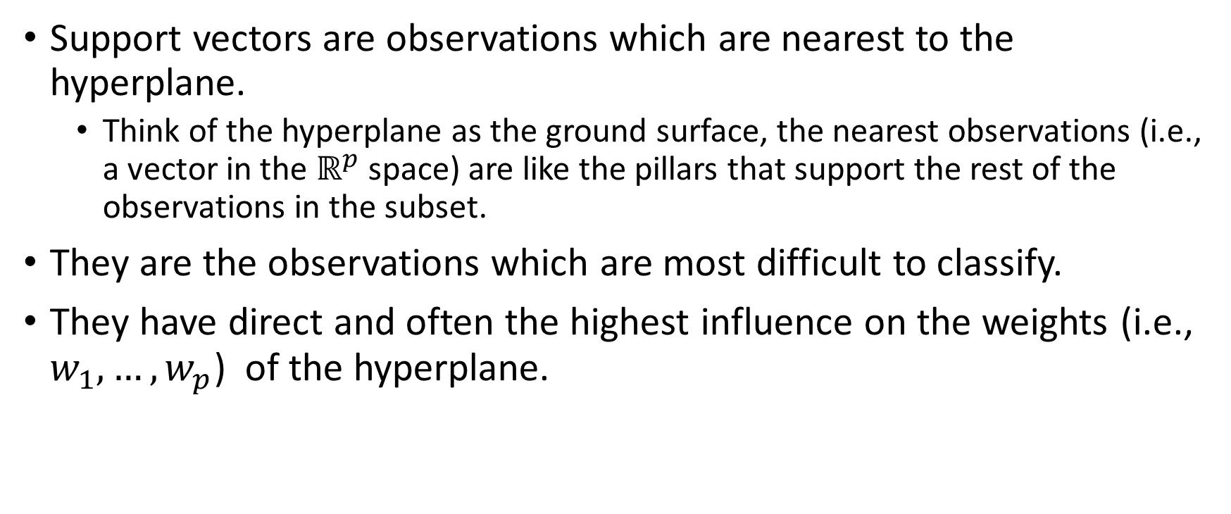
What are the Support Vectors?
Support vectors are observations which are nearest to the hyperplane.
Think of the hyperplane as the ground surface, the nearest observations (i.e., a vector in the $ℝ^{p}$ space) are like the pillars that support the rest of the observations in the subset.
They are the observations which are most difficult to classify.
They have direct and often the highest influence on the weights (i.e., $w_{1},…,w_{p}$) of the hyperplane.

Slide 39
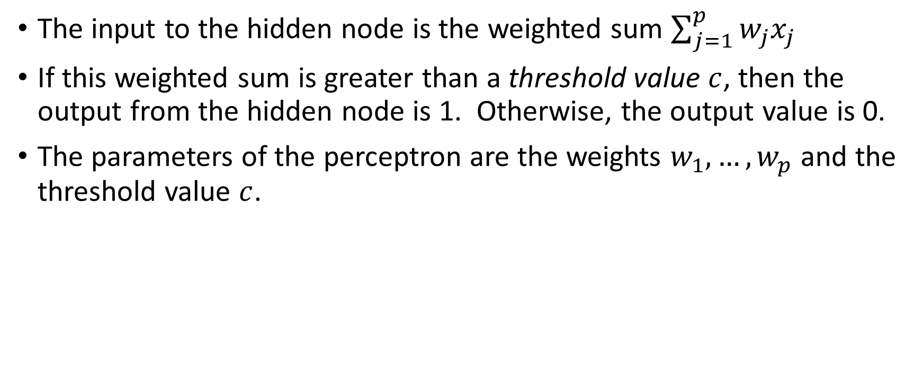
Perceptron Revisited: A Linear Separator
The input to the hidden node is the weighted sum $\sum_{j=1}^{p}{w_{j}x_{j}}$
If this weighted sum is greater than a threshold value $c$, then the output from the hidden node is 1. Otherwise, the output value is 0.
The parameters of the perceptron are the weights $w_{1},…,w_{p}$ and the threshold value $c$.

Slide 40
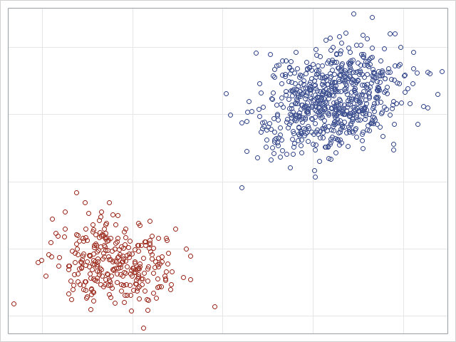
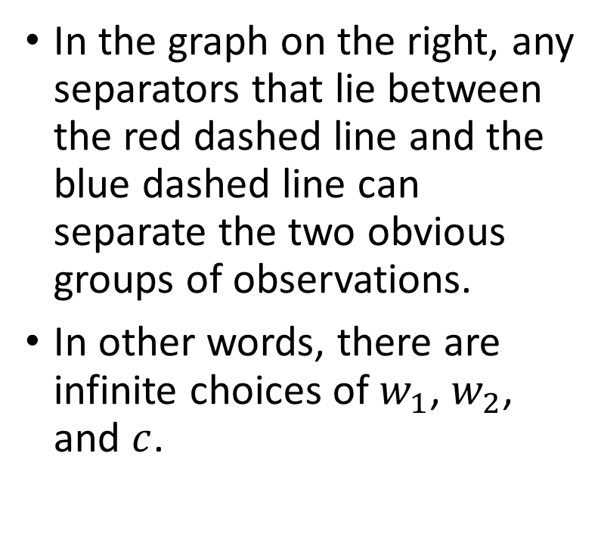
Which Linear Separator?
In the graph on the right, any separators that lie between the red dashed line and the blue dashed line can separate the two obvious groups of observations.
In other words, there are infinite choices of $w_{1}$, $w_{2}$, and $c$.

Slide 41
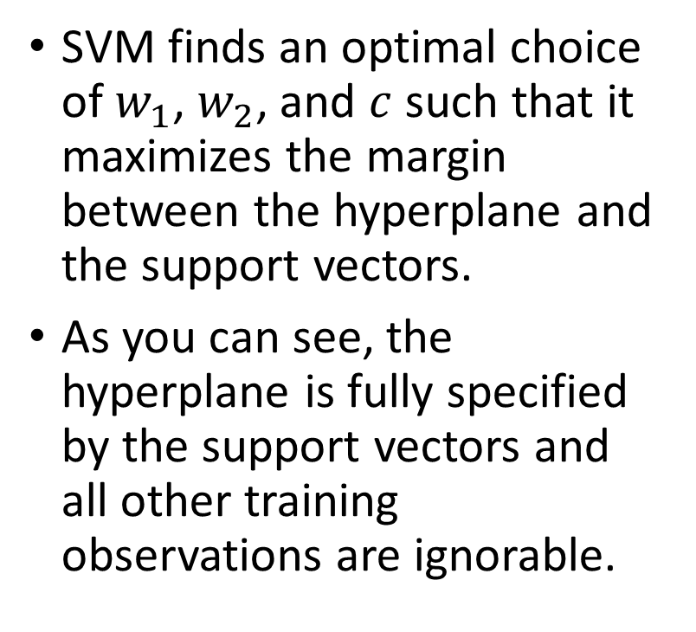
The Optimal Linear Separator
SVM finds an optimal choice of $w_{1}$, $w_{2}$, and $c$ such that it maximizes the margin between the hyperplane and the support vectors.
As you can see, the hyperplane is fully specified by the support vectors and all other training observations are ignorable.
Maximize Margin
Support Vectors

Slide 42
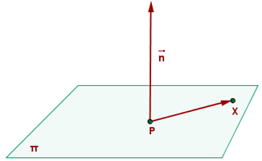
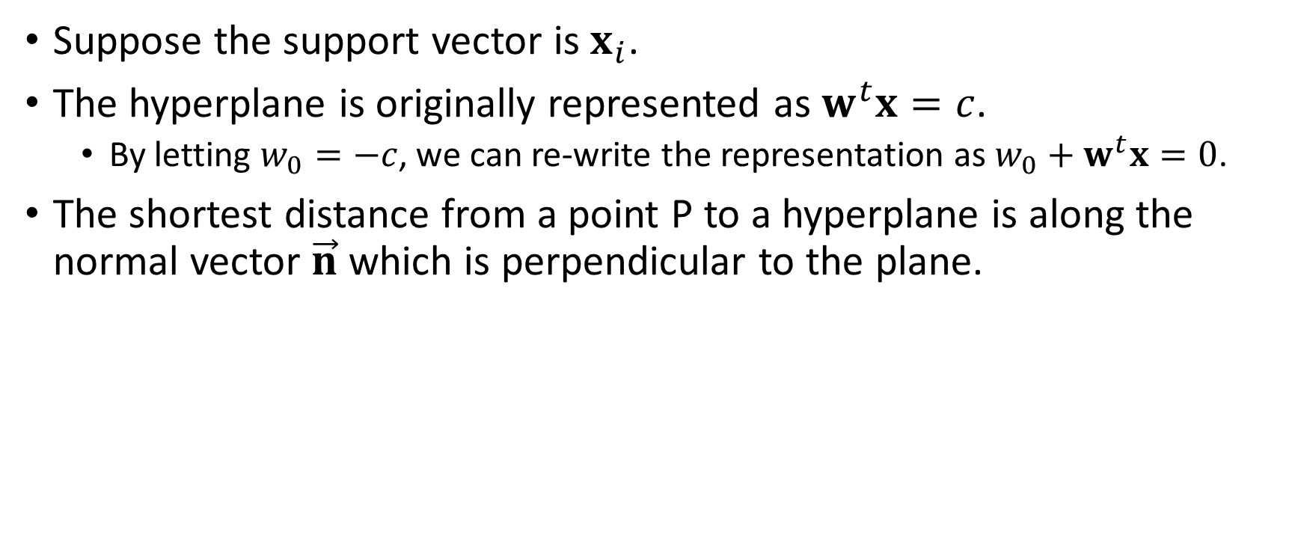
Distance from a Point to a Hyperplane
Suppose the support vector is $x_{i}$.
The hyperplane is originally represented as $w^{t}x=c$.
By letting $w_{0}=−c$, we can re-write the representation as $w_{0}+w^{t}x=0$.
The shortest distance from a point P to a hyperplane is along the normal vector $\vec{n}$ which is perpendicular to the plane.
Source: https://www.ditutor.com/space/normal_vector.html

Slide 43
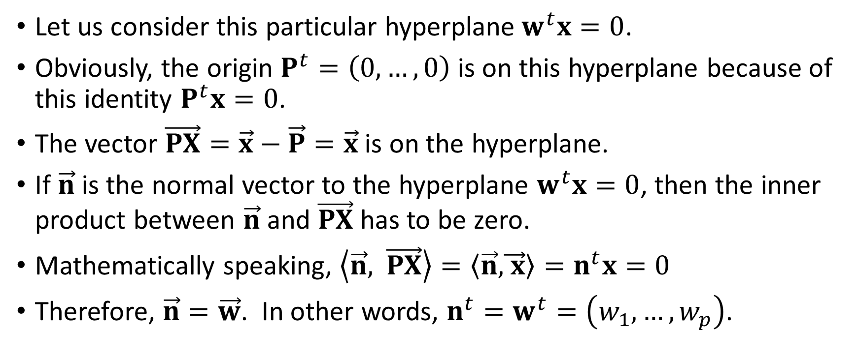
Normal Vector of a Hyperplane
Let us consider this particular hyperplane$w^{t}x=0$.
Obviously, the origin $P^{t}=\left(0,…,0\right)$ is on this hyperplane because of this identity $P^{t}x=0$.
The vector $\vec{PX}=\vec{x}−\vec{P}=\vec{x}$ is on the hyperplane.
If $\vec{n}$ is the normal vector to the hyperplane $w^{t}x=0$, then the inner product between $\vec{n}$ and $\vec{PX}$has to be zero.
Mathematically speaking, $\left\langle \vec{n}\text{,} \vec{PX}\right\rangle =\left\langle \vec{n}\text{,}\vec{ x}\right\rangle =n^{t}x=0$
Therefore, $\vec{n}=\vec{w}$. In other words, $n^{t}=w^{t}=\left(w_{1},…,w_{p}\right)$.

Slide 44
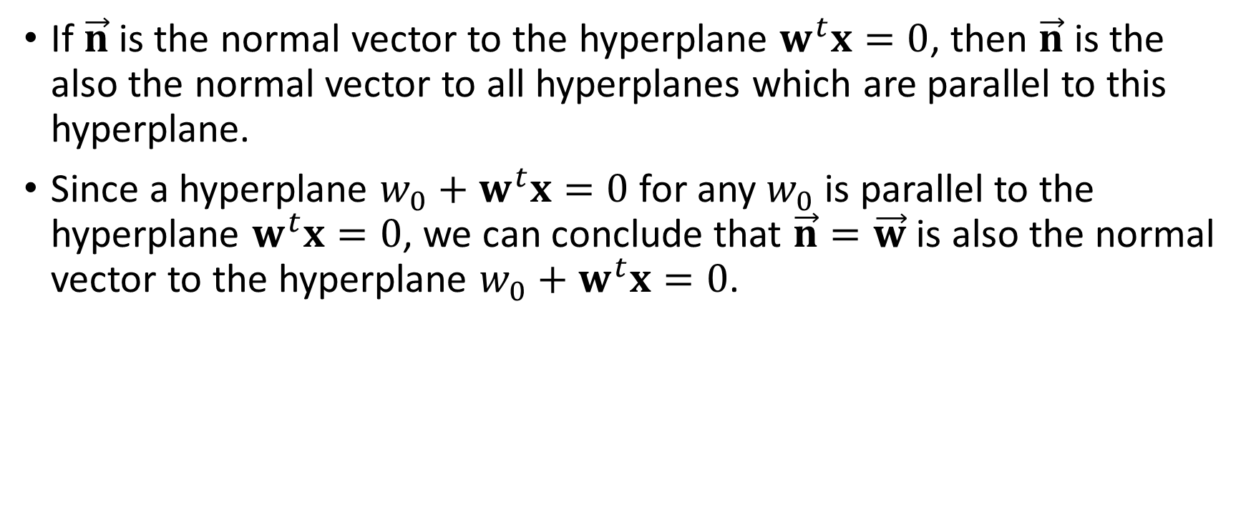
Normal Vector of a Hyperplane
If $\vec{n}$ is the normal vector to the hyperplane $w^{t}x=0$, then $\vec{n}$ is the also the normal vector to all hyperplanes which are parallel to this hyperplane.
Since a hyperplane $w_{0}+w^{t}x=0$ for any $w_{0}$ is parallel to the hyperplane $w^{t}x=0$, we can conclude that $\vec{n}=\vec{w}$ is also the normal vector to the hyperplane $w_{0}+w^{t}x=0$.

Slide 45
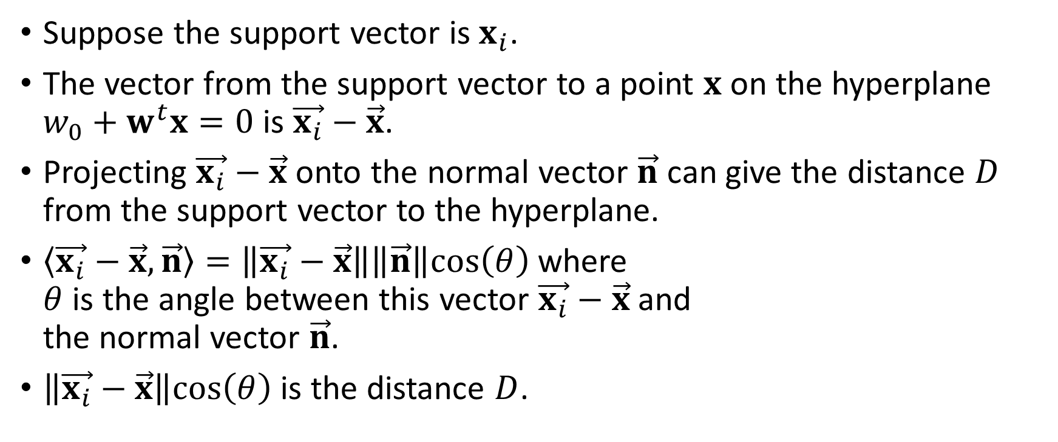

Distance from the Support Vector to a Hyperplane
Suppose the support vector is $x_{i}$.
The vector from the support vector to a point $x$ on the hyperplane $w_{0}+w^{t}x=0$ is $\vec{x_{i}}−\vec{x}$.
Projecting $\vec{x_{i}}−\vec{x}$ onto the normal vector $\vec{n}$ can give the distance $D$ from the support vector to the hyperplane.
$\left\langle \vec{x_{i}}−\vec{x}, \vec{n}\right\rangle =\left\|\vec{x_{i}}−\vec{x}\right\|\left\|\vec{n}\right\|cos\left(θ\right)$ where $θ$ is the angle between this vector $\vec{x_{i}}−\vec{x}$ and the normal vector $\vec{n}$.
$\left\|\vec{x_{i}}−\vec{x}\right\|cos\left(θ\right)$ is the distance $D$.
$$x_{i}$$

Slide 46
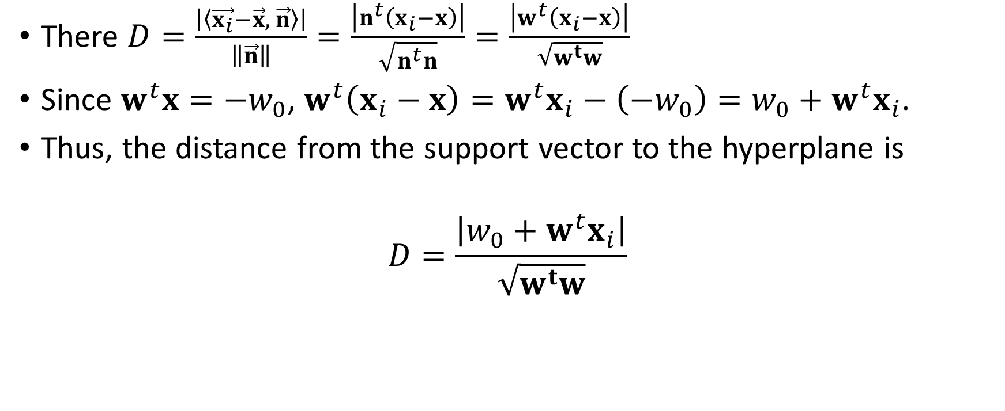
Distance from the Support Vector to a Hyperplane
There $D=\frac{\left|\left\langle \vec{x_{i}}−\vec{x}, \vec{n}\right\rangle \right|}{\left\|\vec{n}\right\|}=\frac{\left|n^{t}\left(x_{i}−x\right)\right|}{\sqrt{n^{t}n}}=\frac{\left|w^{t}\left(x_{i}−x\right)\right|}{\sqrt{w^{t}w}}$
Since $w^{t}x=−w_{0}$, $w^{t}\left(x_{i}−x\right)=w^{t}x_{i}−\left(−w_{0}\right)=w_{0}+w^{t}x_{i}$.
Thus, the distance from the support vector to the hyperplane is
$$D=\frac{\left|w_{0}+w^{t}x_{i}\right|}{\sqrt{w^{t}w}}$$
Source: https://www.ditutor.com/space/normal_vector.html

Slide 47
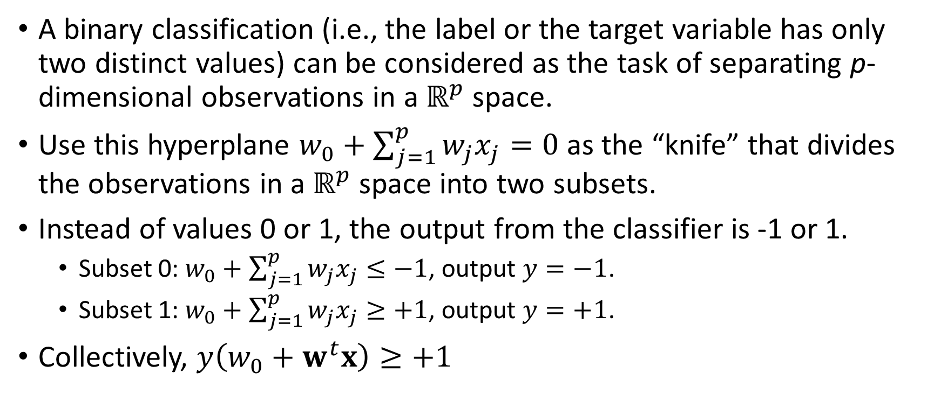
From Perceptron to Support Vector Machines
A binary classification (i.e., the label or the target variable has only two distinct values) can be considered as the task of separating p-dimensional observations in a $ℝ^{p}$ space.
Use this hyperplane $w_{0}+\sum_{j=1}^{p}{w_{j}x_{j}=0}$ as the “knife” that divides the observations in a $ℝ^{p}$ space into two subsets.
Instead of values 0 or 1, the output from the classifier is -1 or 1.
Subset 0: $w_{0}+\sum_{j=1}^{p}{w_{j}x_{j}≤−1}$, output $y=−1$.
Subset 1: $w_{0}+\sum_{j=1}^{p}{w_{j}x_{j}≥+1}$, output $y=+1$.
Collectively, $y\left(w_{0}+w^{t}x\right)≥+1$

Slide 48
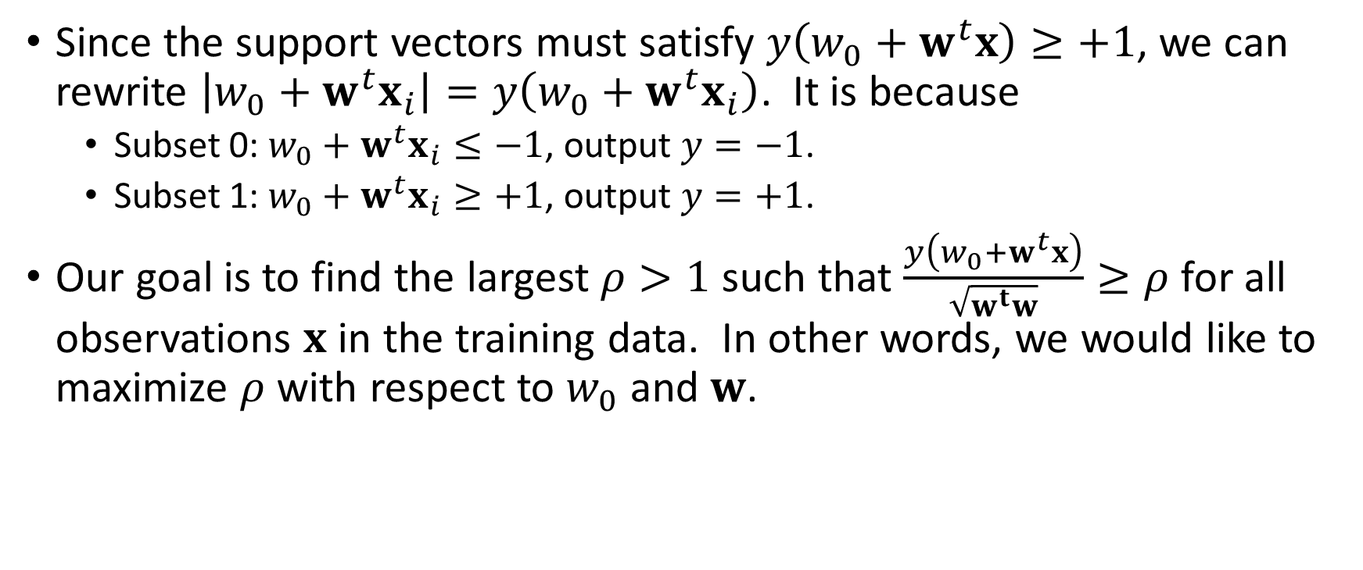
Maximizing the Margin
Since the support vectors must satisfy $y\left(w_{0}+w^{t}x\right)≥+1$, we can rewrite $\left|w_{0}+w^{t}x_{i}\right|=y\left(w_{0}+w^{t}x_{i}\right)$. It is because
Subset 0: $w_{0}+w^{t}x_{i}≤−1$, output $y=−1$.
Subset 1: $w_{0}+w^{t}x_{i}≥+1$, output $y=+1$.
Our goal is to find the largest $ρ>1$ such that $\frac{y\left(w_{0}+w^{t}x\right)}{\sqrt{w^{t}w}}≥ρ$ for all observations $x$ in the training data. In other words, we would like to maximize $ρ$ with respect to $w_{0}$ and $w$.

Slide 49
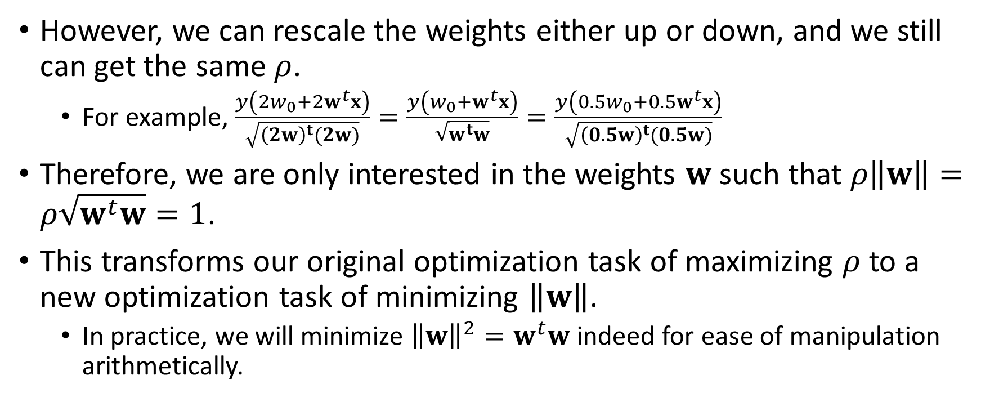
Minimizing the Norm of the Weights
However, we can rescale the weights either up or down, and we still can get the same $ρ$.
For example, $\frac{y\left(2w_{0}+2w^{t}x\right)}{\sqrt{{\left(2w\right)}^{t}(2w)}}=\frac{y\left(w_{0}+w^{t}x\right)}{\sqrt{w^{t}w}}=\frac{y\left(0.5w_{0}+0.5w^{t}x\right)}{\sqrt{{\left(0.5w\right)}^{t}(0.5w)}}$
Therefore, we are only interested in the weights $w$ such that $ρ\left\|w\right\|=ρ\sqrt{w^{t}w}=1$.
This transforms our original optimization task of maximizing $ρ$ to a new optimization task of minimizing $\left\|w\right\|$.
In practice, we will minimize ${\left\|w\right\|}^{2}=w^{t}w$ indeed for ease of manipulation arithmetically.

Slide 50
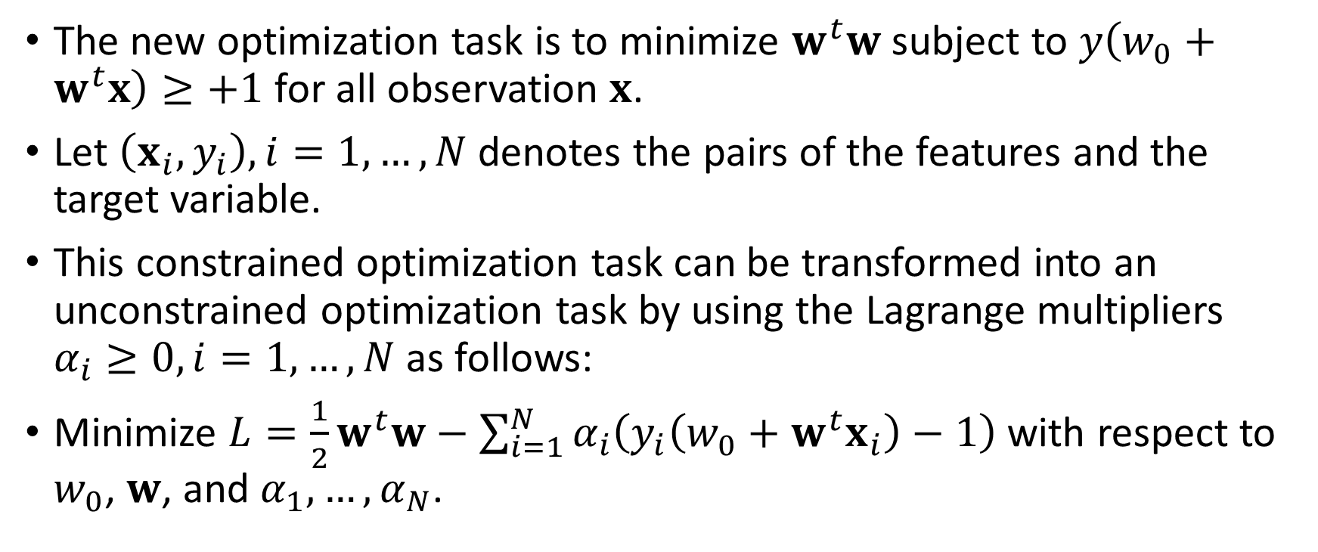
The Unconstrained Minimization Problem
The new optimization task is to minimize $w^{t}w$ subject to $y\left(w_{0}+w^{t}x\right)≥+1$ for all observation $x$.
Let $\left(x_{i},y_{i}\right),i=1,…,N$ denotes the pairs of the features and the target variable.
This constrained optimization task can be transformed into an unconstrained optimization task by using the Lagrange multipliers $α_{i}≥0, i=1,…,N$ as follows:
Minimize $L=\frac{1}{2}w^{t}w−\sum_{i=1}^{N}{α_{i}\left(y_{i}\left(w_{0}+w^{t}x_{i}\right)−1\right)}$ with respect to $w_{0}$, $w$, and $α_{1},…,α_{N}$.

Slide 51
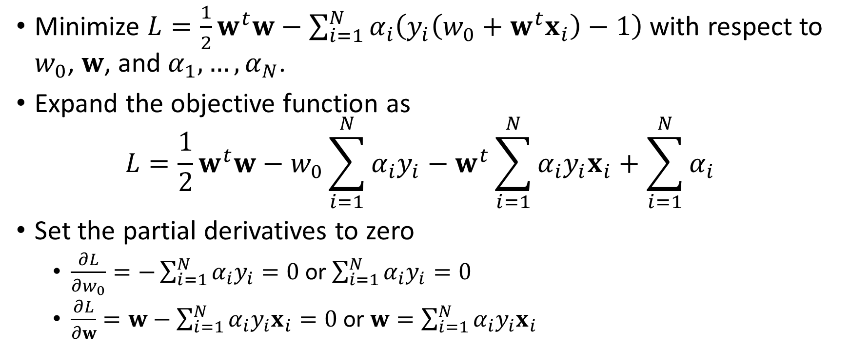
The Unconstrained Minimization Problem
Minimize $L=\frac{1}{2}w^{t}w−\sum_{i=1}^{N}{α_{i}\left(y_{i}\left(w_{0}+w^{t}x_{i}\right)−1\right)}$ with respect to $w_{0}$, $w$, and $α_{1},…,α_{N}$.
Expand the objective function as $L=\frac{1}{2}w^{t}w−w_{0}\sum_{i=1}^{N}{α_{i}y_{i}}−w^{t}\sum_{i=1}^{N}{α_{i}y_{i}x_{i}}+\sum_{i=1}^{N}{α_{i}}$
Set the partial derivatives to zero
$\frac{∂L}{∂w_{0}}=−\sum_{i=1}^{N}{α_{i}y_{i}}=0$ or $\sum_{i=1}^{N}{α_{i}y_{i}}=0$
$\frac{∂L}{∂w}=w−\sum_{i=1}^{N}{α_{i}y_{i}x_{i}}=0$ or $w=\sum_{i=1}^{N}{α_{i}y_{i}x_{i}}$

Slide 52
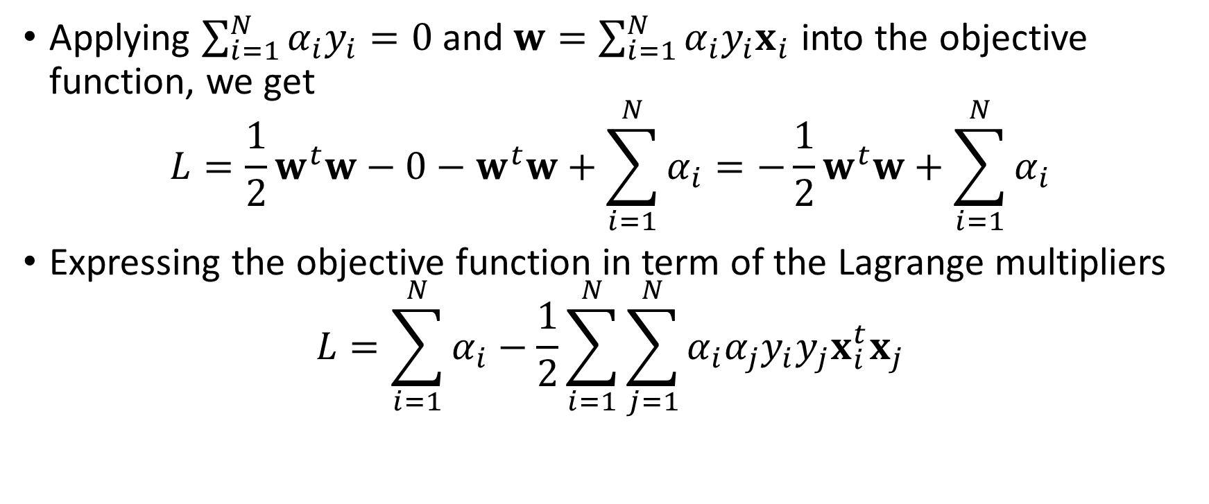
The Unconstrained Minimization Problem
Applying $\sum_{i=1}^{N}{α_{i}y_{i}}=0$ and $w=\sum_{i=1}^{N}{α_{i}y_{i}x_{i}}$ into the objective function, we get
$$L=\frac{1}{2}w^{t}w−0−w^{t}w+\sum_{i=1}^{N}{α_{i}}=−\frac{1}{2}w^{t}w+\sum_{i=1}^{N}{α_{i}}$$
Expressing the objective function in term of the Lagrange multipliers
$$L=\sum_{i=1}^{N}{α_{i}}−\frac{1}{2}\sum_{i=1}^{N}{\sum_{j=1}^{N}{α_{i}α_{j}y_{i}y_{j}x_{i}^{t}x_{j}}}$$

Slide 53
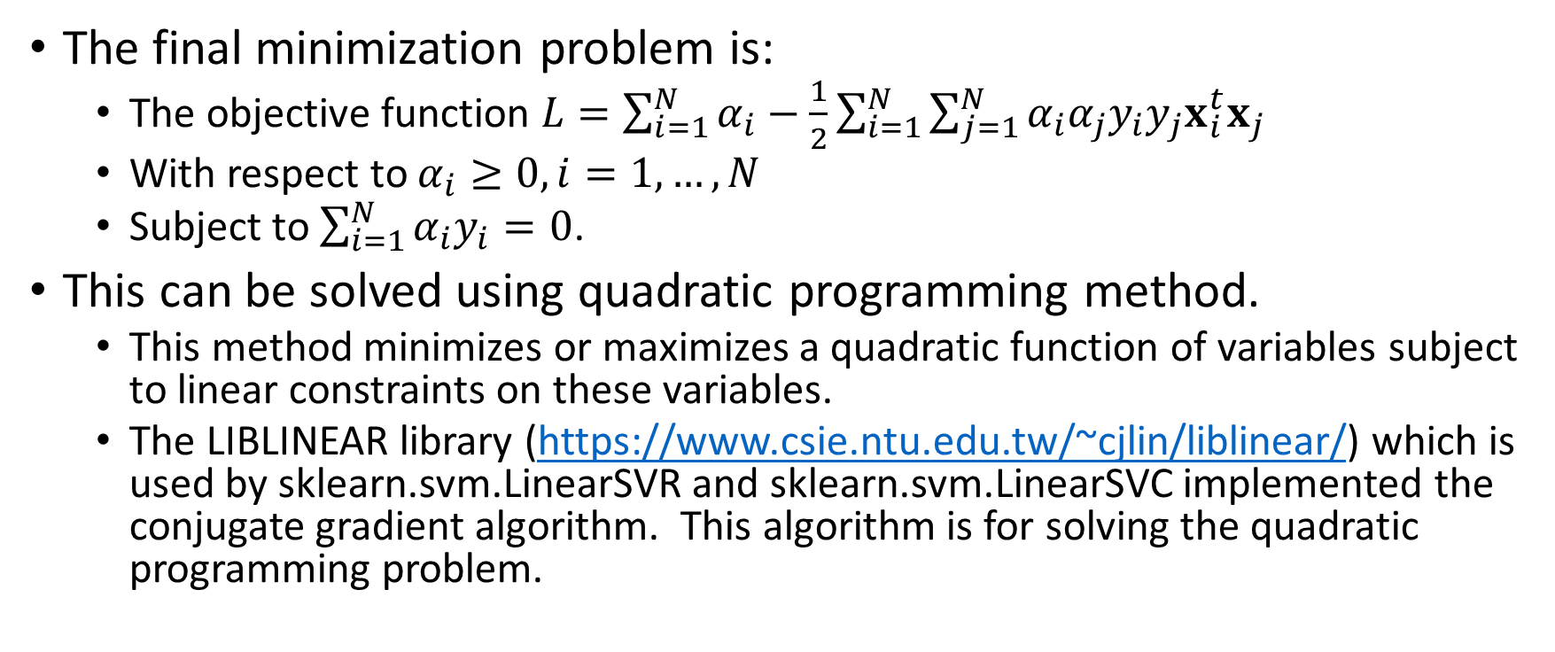
The Unconstrained Minimization Problem
The final minimization problem is:
The objective function $L=\sum_{i=1}^{N}{α_{i}}−\frac{1}{2}\sum_{i=1}^{N}{\sum_{j=1}^{N}{α_{i}α_{j}y_{i}y_{j}x_{i}^{t}x_{j}}}$
With respect to $α_{i}≥0,i=1,…,N$
Subject to $\sum_{i=1}^{N}{α_{i}y_{i}}=0$.
This can be solved using quadratic programming method.
This method minimizes or maximizes a quadratic function of variables subject to linear constraints on these variables.
The LIBLINEAR library (https://www.csie.ntu.edu.tw/~cjlin/liblinear/) which is used by sklearn.svm.LinearSVR and sklearn.svm.LinearSVC implemented the conjugate gradient algorithm. This algorithm is for solving the quadratic programming problem.

Slide 54
A Supervised Classification Problem
Let us try the sklearn.svm.LinearSVC for classifying the toy data.
trainData = pandas.DataFrame(mvnData[:,[1,2]], columns = ['x', 'y'])
yTrain = pandas.DataFrame(mvnData[:,0], columns = ['group']).astype('category')
svm_Model = svm.LinearSVC(verbose = 1, random_state = 20181107, max_iter = 1000)
thisFit = svm_Model.fit(trainData, yTrain)
print('Intercept:\n', thisFit.intercept_)
print('Weight Coefficients:\n', thisFit.coef_)
y_predictClass = thisFit.predict(trainData)
print('Mean Accuracy = ', metrics.accuracy_score(yTrain, y_predictClass))
trainData['_PredictedClass_'] = y_predictClass
svm_Mean = trainData.groupby('_PredictedClass_').mean()
print(svm_Mean)

Slide 55
A Supervised Classification Problem
Mean accuracy = 0.977
Intercept = -0.53415939
Weights coefficients = [[-0.92853733 -0.68382709]]

Slide 56
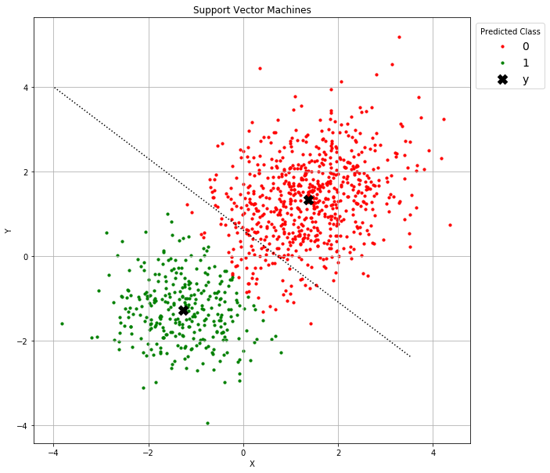
A Supervised Classification Problem
The hyperplane (which is the dotted line in the graph on the right) is -0.92853733 * x -0.68382709 * y = -0.53415939
The means of the predicted class, marked X in the chart, are: [[ 1.374464 1.338855] [-1.272702 -1.280386]]
How successful do you think the hyperplane in dividing the two populations?

Slide 57
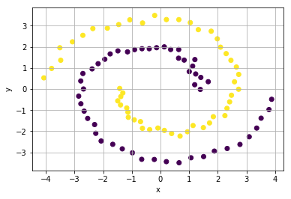
The Two Spirals Classification Problem
Let us try the sklearn.svm.LinearSVC for classifying the toy data.
# Try the sklearn.svm.LinearSVC
XTrain = Spiral[['x', 'y']]
yTrain = Spiral['SpectralCluster']
svm_Model = svm.LinearSVC(verbose = 1, random_state = 20190410, max_iter = 1000)
thisFit = svm_Model.fit(XTrain, yTrain)
print('Intercept:\n', thisFit.intercept_)
print('Weight Coefficients:\n', thisFit.coef_)
y_predictClass = thisFit.predict(XTrain)
print('Mean Accuracy = ', metrics.accuracy_score(yTrain, y_predictClass))
XTrain['_PredictedClass_'] = y_predictClass
svm_Mean = XTrain.groupby('_PredictedClass_').mean()
print(svm_Mean)
Week 13 Spiral SVM.py

Slide 58
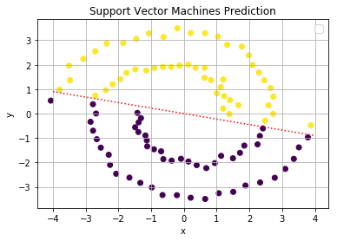
A Supervised Classification Problem
Mean accuracy = 0.5
Intercept = 0.0015
Weights coefficients = [[-0.0272, 0.1182]]
The hyperplane (which is the dotted line in the graph on the right) is 0.0272 * x + 0.1182 * y = -0.0015
How successful do you think the hyperplane in dividing the two spirals?

Slide 59
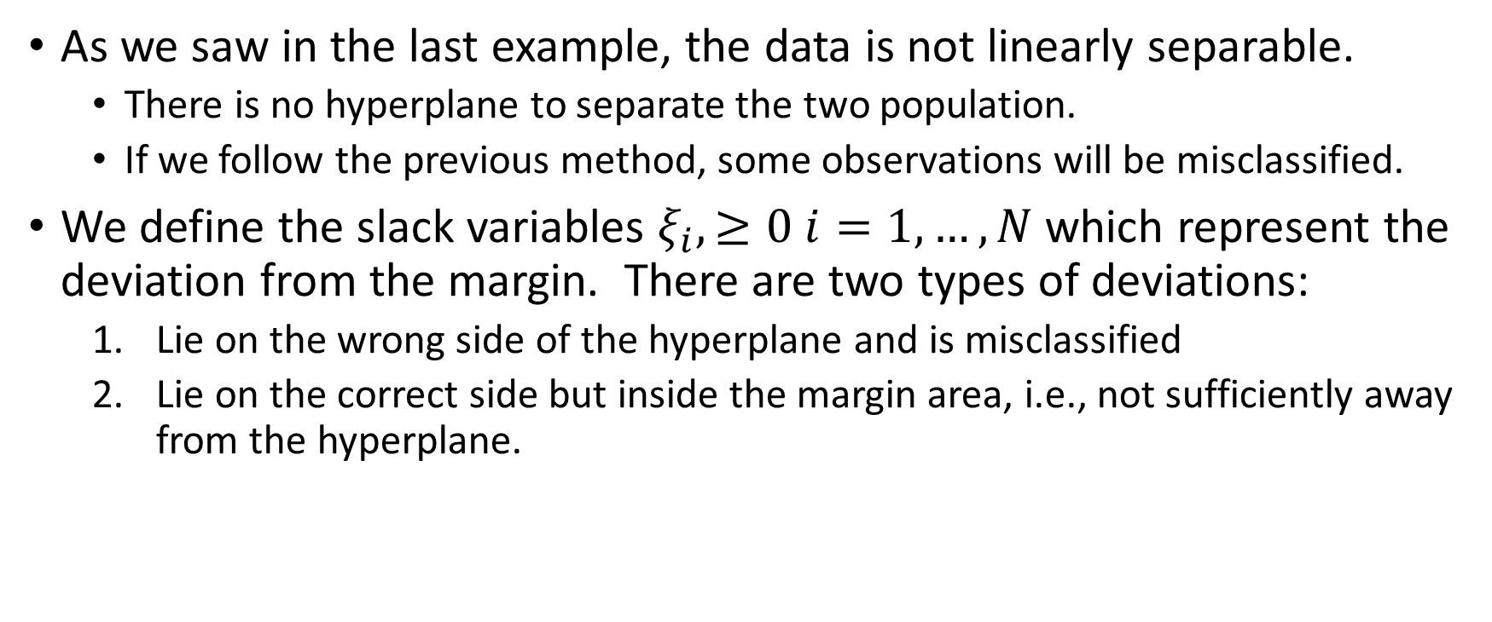
The Non-separable Case
As we saw in the last example, the data is not linearly separable.
There is no hyperplane to separate the two population.
If we follow the previous method, some observations will be misclassified.
We define the slack variables $ξ_{i},≥0 i=1,…,N$ which represent the deviation from the margin. There are two types of deviations:
Lie on the wrong side of the hyperplane and is misclassified
Lie on the correct side but inside the margin area, i.e., not sufficiently away from the hyperplane.

Slide 60
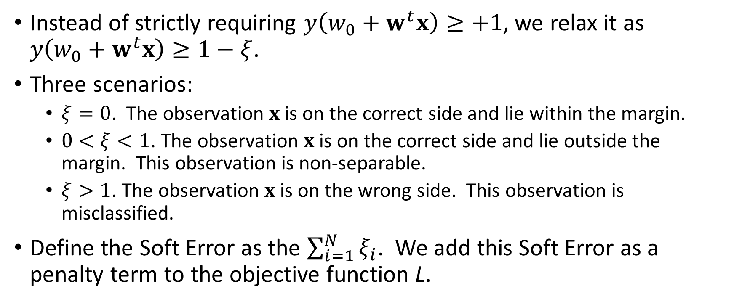
The Non-separable Case
Instead of strictly requiring $y\left(w_{0}+w^{t}x\right)≥+1$, we relax it as $y\left(w_{0}+w^{t}x\right)≥1−ξ$.
Three scenarios:
$ξ=0$. The observation $x$ is on the correct side and lie within the margin.
$0<ξ<1$. The observation $x$ is on the correct side and lie outside the margin. This observation is non-separable.
$ξ>1$. The observation $x$ is on the wrong side. This observation is misclassified.
Define the Soft Error as the $\sum_{i=1}^{N}{ξ_{i}}$. We add this Soft Error as a penalty term to the objective function L.

Slide 61
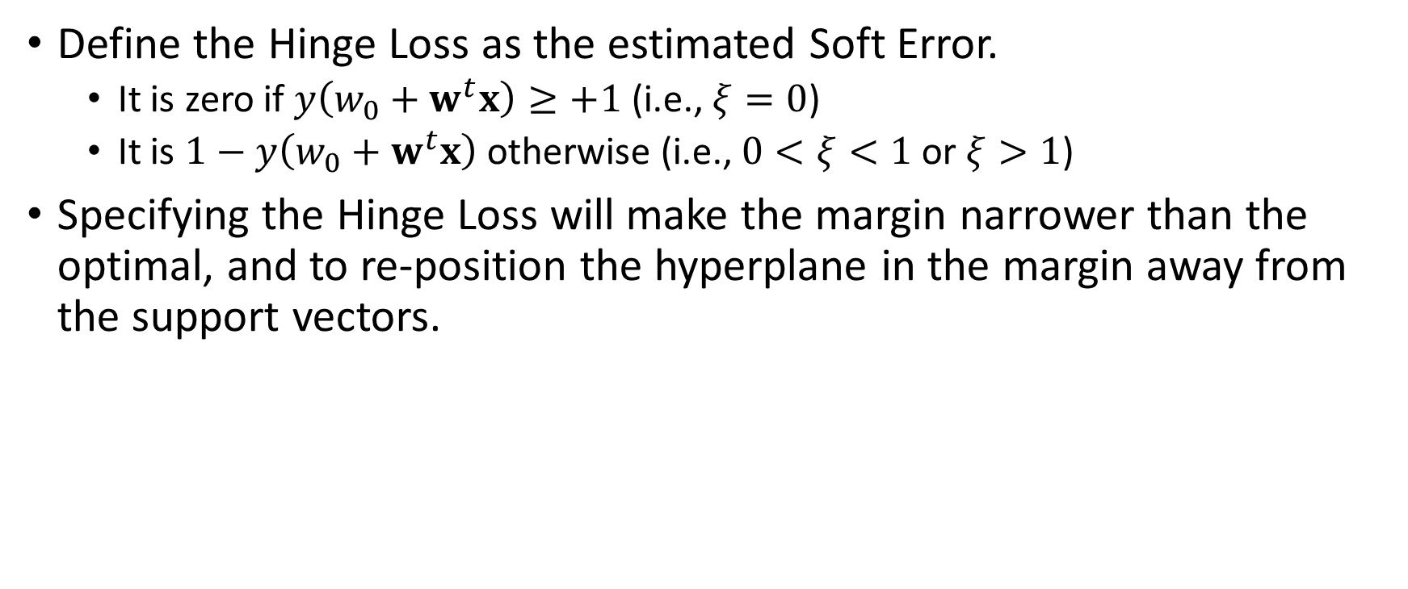
The Non-separable Case
Define the Hinge Loss as the estimated Soft Error.
It is zero if $y\left(w_{0}+w^{t}x\right)≥+1$ (i.e., $ξ=0$)
It is $1−y\left(w_{0}+w^{t}x\right)$ otherwise (i.e., $0<ξ<1$ or $ξ>1$)
Specifying the Hinge Loss will make the margin narrower than the optimal, and to re-position the hyperplane in the margin away from the support vectors.

Slide 62
Multi-Class Target Variable
If the label or the target variable has more than two categories, the classification can be done in:
One class versus another class. One SVM classifier for each pair of classes.
One class versus all the other classes. One SVM classifier for each pair of a class versus the otherwise.
Crammer-Singer method. Koby Crammer and Yoram Singer (2001). "On the Algorithmic Implementation of Multiclass Kernel-based Vector Machines". Journal of Machine Learning Research, 2, 265-292.

Slide 63
Final Remarks
Support Vector Machines are primarily for classification of a binary target variable.
In addition to classification, Support Vector Machines provide the line in the sand. The line ensures that the margin between the line and the support vectors are widest. This helps the prediction of new data.
Support Vector Machines work well for groups of compact observations. However, it is likely to fail for groups of connected observations.

Slide 64
Some Dates to be Noted
Assignment 5
Will be posted before the end of Saturday, April 13, 2019
Due date is 11:59 pm on Saturday, April 27, 2019
Take Home Final Exam
Will be posted at 12 Noon on Thursday, May 2, 2019
Due date is 12 Noon on Thursday, May 9, 2019
Class Schedule
The last lecture is on Wednesday, April 24, 2019
No Instructor Office Hour on Monday, April 29
The last Instructor Office Hour is on Monday, May 6, 2019

